Slide 1
Music Recommendation System
The most effective way to enhance customer experience and satisfaction with an added bonus of maximum customer interaction without fear of privacy invasion.

Slide 2
Overwhelming amounts of information can make customers reluctant to engage.
Fitting new customers to new items with limited knowledge is the crux.
Recommendation systems that accurately match users to items.
Systems that maximize customer experience, quickly.
Problem Definition

Slide 3
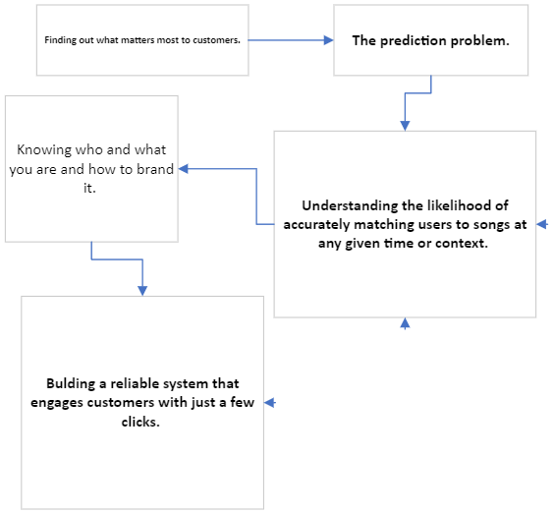
Problems to solve

Slide 4
Increasing customer engagement Through Networking
Eliminate guesswork for customers. This allows predictions to be more precise and accurate, but also more fulfilling.
Ease/address customer concerns. Gives any recommendation system more reliable, honest data.
Parse the mass amounts of information for every user, with precision, using the simplest methods available.

Slide 5
What are we predicting, exactly?
How to:
Find Unkown Values
Increase revenue through multiple streams
Engage new customers while keeping older customers satisfied.
Ensure more 'unpopular' items have more available space to garnish attention and bring new revenue

Slide 6
Honesty matters!
Cold start problems cause much distress with both users and platforms
Apprehension of privacy concerns reduce interaction and trust
Distrust creates information bubbles.
Ratings are important, convince as many users as possible as this is the simplest solution available.
Honesty branding invigorates customer engagement! Simple and easy to implement.

Slide 7
Do recommendation systems work?
Completing the matrix
Engagement eliminates the need for guesswork
Sophisticated methods require large data; music 'fits the data'
Allows for mimimum privacy concerns and invasions through item-item networking
Bound only by number of users

Slide 8
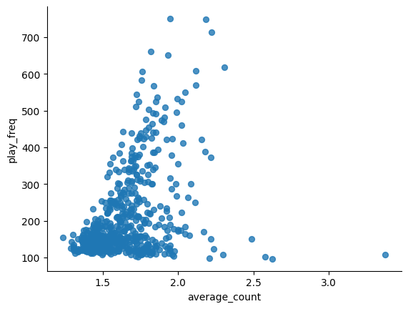
Solutions Approach
Test and build systems that accurately match users with songs, as quickly as possibly while maximizing user interaction.
Produce estimation for Lij:
*A small sample of parameters
Used to build prediction models.

Slide 9
Popularity ranking for the win
Simplest, most reliable method.
This however requires more customer engagement.
Requires data shrinkage.
Encourages networking.
May leave relevant items missing because of skewed or biased data

Slide 10
User-User interactions are effective...mostly.
Cold start problems can hamper prediction efforts.
Requires users to trust the platform, even through limited interaction.
Robust, reliable information produces high recall value.
More likely to retain current customers as more data is created.

Slide 11
Item-Item predictions are a top contender.
Requires unique customer engagement, meaning attracting new users.
Works very well through networking and KNN, as most users specificity in buying any items are easier to connect.
Can leave unpopular items untested, meaning unexplored avenues of revenue.

Slide 12
Model based Collaborative filtering and Matrix Factorization
Easier to predict as it requires only user's past behavior; meaning customers already trust the brand and what it offers, reducing guesswork.
Most robust model, requiring only the knowledge of past behavior; no privacy invasion concerns
Increased accuracy and precision assures users of platform's capabilities.
Sophisticated methods easily solve multiple prediction problems.
Can easily create information bubbles, may limit user's desire to find new items due to ultimate satisfaction with results (overperforming).

Slide 13
Cluster based models need assistance...asap.
Perhaps most effective solution for cold start problems, but relies heavily on user provided information, creating a privacy concern.
Scalability and Flexibility is unmatched when all parameters are met.
Outliers can create and enforce significant biases (feedback loops).
Higher error rate than other models, but performance increases when hybridized and optimized.

Slide 14
Content based models are excellent solutions.
Requires customer engagement and interaction but little personal information, alleviating privacy concerns.
Relies heavily on popularity, garnered through ratings, playbacks, song choice and item tastes.
Can create small feedback loops but if hybridized, can accurately predict user preferences and subsequent engagement.

Slide 15
Proposed model solution
A hybrid system emphasizing high precision and accuracy, while ensuring maximized recall and minimal required personal information from users.
Popular items will automatically attract new users but holding their attention requires further initiation.
Clustering is a powerful model for cold start problems, with the cons leveled out by more robust, optimized methods.
Model Based and Matrix factorization can easily fill in unknown values and improve relevancy.
Content based algorithms allow for easier new user freedom, creating trust and increasing the likelyhood of further engagement.

Slide 16
Business Solutions
Hybrid solution
Model based matrix factorization
Rank/popularity
SClustering
Content based recommendation
1
2
3
4
5

Slide 17
Summary
Proposal for the future solution design and outlook: Because of the large data set and the sparse data included, a hybrid recommendation system is necessary to provide the best possible scenarios involving the users, songs and the platform needs. Using all of these recommendation systems together should provide a robust, precise and accurate system;
Rank/Popularity - based recommendation system User-User similarity-based collaborative filtering Item-Item similarity-based collaborative filtering Model based collaborative filtering / Matrix factorization
Clustering - based recommendation system Content based recommendation system The popularity - based recommendation system would be helpful in the case of cold start problems.
The model-based collaborative filtering/ matrix factorization is advantageous as it can handle sparse data since it can predict missing ratings by estimating the values based on the learned latent factors. It can also capture complex patterns and relationships in user-item interactions, making it suitable for personalized recommendations.
The content based recommendation system, uses other features ( "title", "release", "artist_name") instead of play_count, with additional text data.

Slide 18
Thank you

